Slide 1
Janus – Evasion car
Cesar Galan

Slide 2
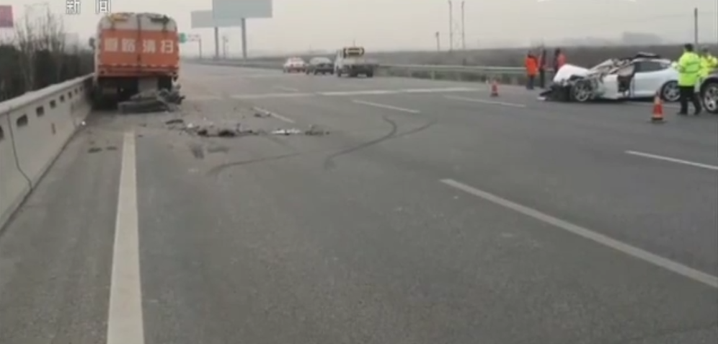
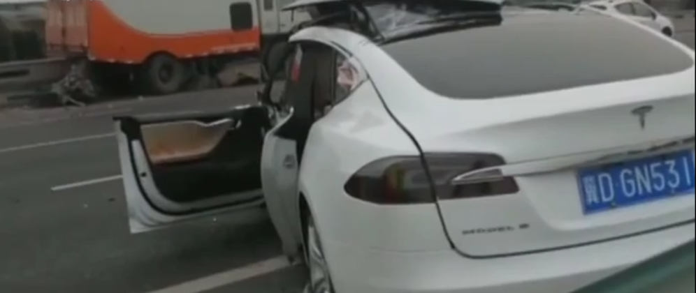
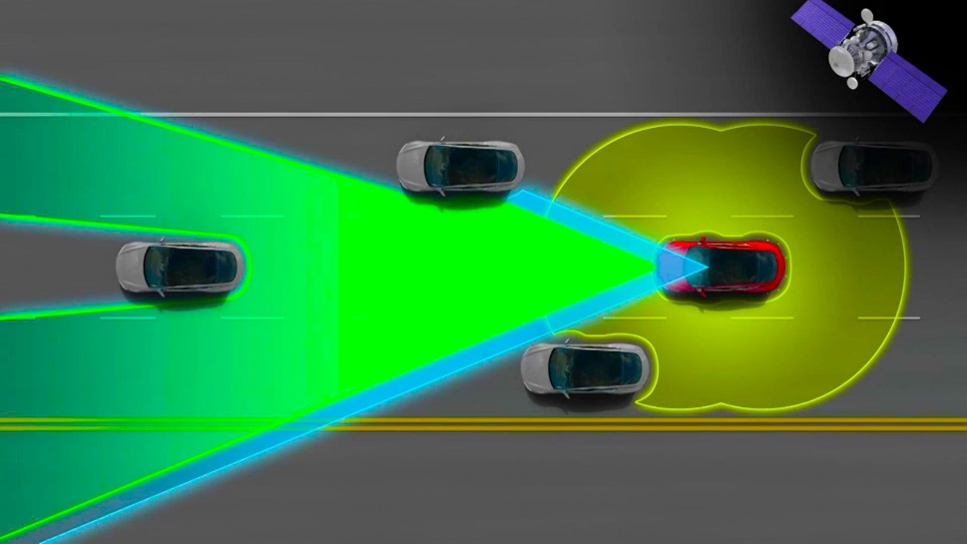
Background
Tesla’s autonomous car cannot detect stationary objects at high speeds
I wanted to find a solution to this problem using sonar sensors
Later found out, Tesla went around this problem by adding a sonar sensor in front of the car and two to the sides

Slide 3
Project Overview
Goals:
Control the speed of a car as it approaches an obstacle
Stop the car at some distance from the wall
Car needs to go at full speed when there is not a wall
Strategy:
Use an ultrasonic sensor to identify the distance from an obstacle
Control the speed of the car by changing the PWM signal into the motor driver

Slide 4
Hardware
Part Name | Source | Specs
Ultrasonic sensor HC-SR04 | Gear Best | Distance detection: 2cm – 450cm ± .3cm Sensor Angle: 15 degrees Voltage output: 5V at 2mA
29:1 Metal Gearmotor #1162 | Trudy’s shop/ Pololu | No load Speed @ 6: 450 RPM No-Load Current @6: 250 mA Stall Torque @6: 25 oz-in
DRV8838 Single Brushed DC Motor Driver Carrier | Pololu | Motor supply voltage: 0V – 11V Logic supply voltage: 1.8V – 7V PHASE/ENABLE interface to control direction and speed
Breadboard | Sparkfun | -
Pillow block bearing | McMaster | Max Speed: 56000 RPM
Acrylic | Laser Cutter room | -
Wheels and shaft | Goodwill | -

Slide 5
System block diagram
Ultrasonic sensor: Reads the distance
PIC18: Computes the power based on error and displays the variables
Motor driver: Controls the output current into DC motor
DC Motor: Controls the speed of the car

Slide 6
Circuit diagram
RC2: Controls the motor speed
RE0: Turns the motor on and off
RE1: Triggers the sonic sensor
RD4: Reads when the signal is back

Slide 7
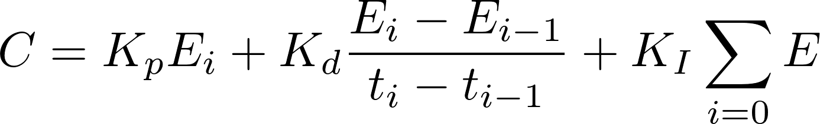
Software
Initialization: Initialize all of the pins and LCD as well as dummy variables
Measure distance: Find the distance from the wall
Calculate power: Computes error and uses control law to find the output power
Outputs PWM signal: Interrupts on compare CCP1 to enter the low priority interrupt

Slide 8
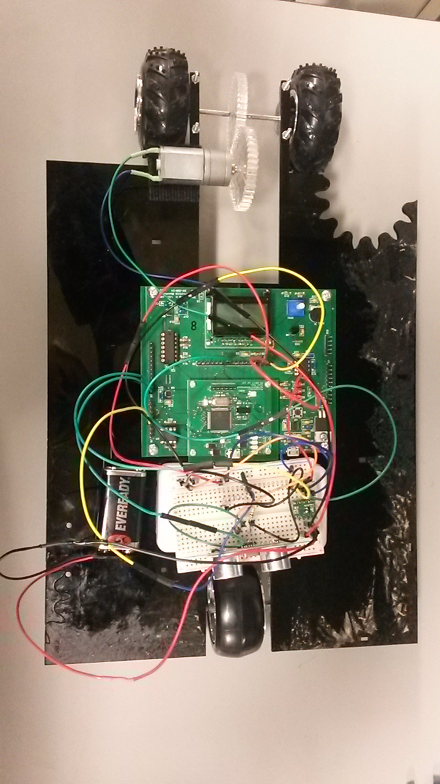
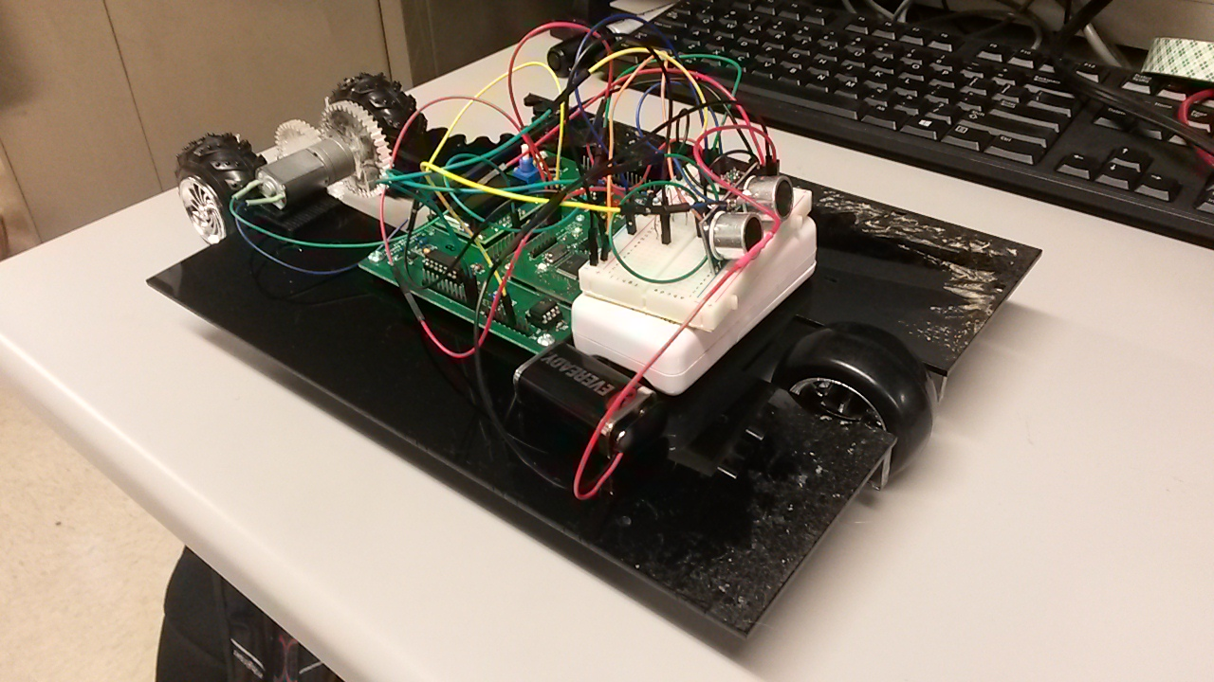
Final product

Slide 9
Lessons Learned
Problems:
Interfacing: Gear alignment
CCP1 falling behind the timer1
PWM signal not working for values other than 50%
Going from error to power into the motor
Solutions:
Apoxy the motor prevent vibrations at low speeds
Not adding the correct amount to the CCP extension
Scale the control to the max error over max power

Slide 10
Final Product performance
Needs above 50% PWM signal in order for the car to overcome weight
The code cap the max power to be 90%
Proportional gain was found to be around 2
Car does not move fast enough to implement PI or PD control
though it is incorporated into the code

Slide 11
Thanks
Trudy: Guiding me on the construction of the car
Devon and Lewis: For debugging my code over and over
Codie: For letting me borrow the phone charger
Grant: For the Velcro and 9 volt battery

Slide 12
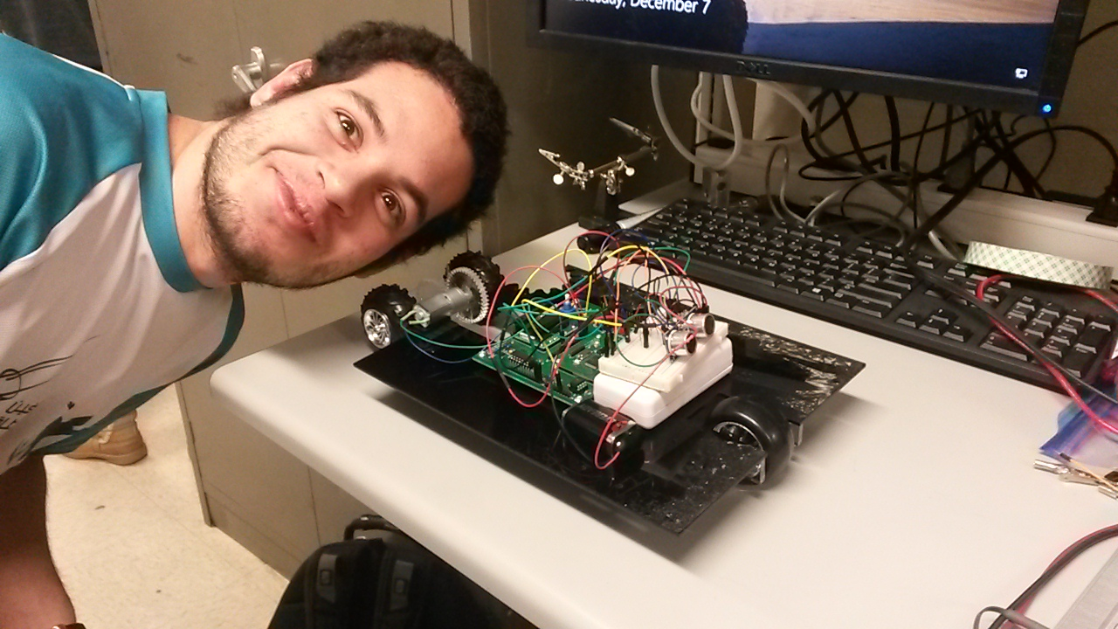
Questions?

